Slide 1

Jolyon Nicks

Slide 2
Pardon?

Slide 3
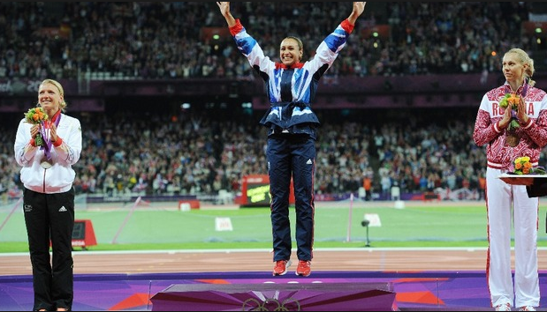
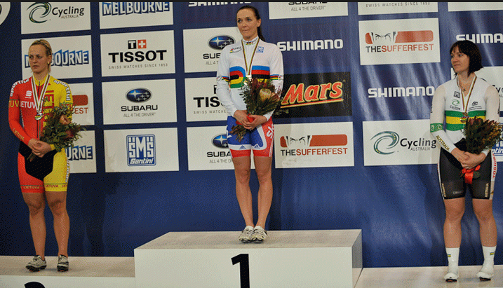
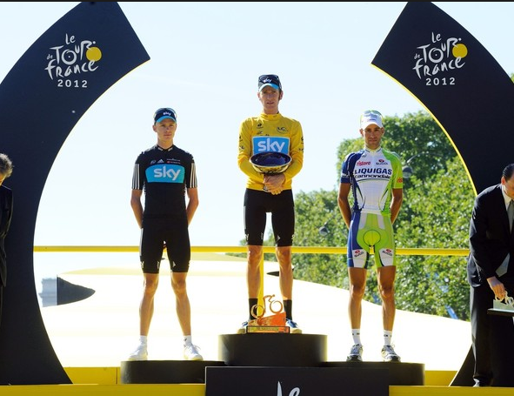
Jolyon as in Podium

Slide 4

UK
17 years
School in Harare, Zimbabwe
Early career, Pretoria
University Cape Town

Slide 5
Jolyon Nicks
Software Engineer

Slide 6
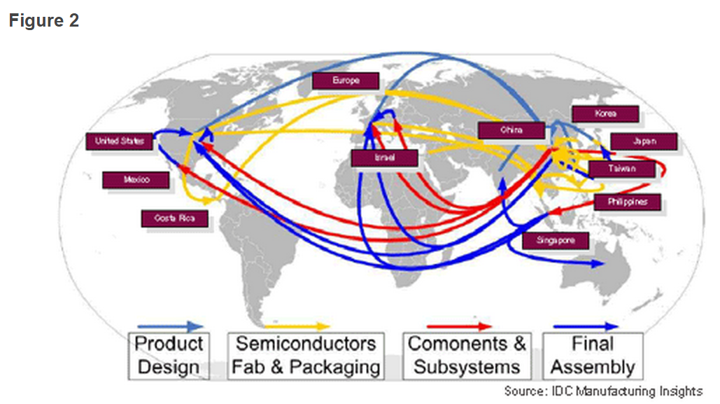

Slide 7


Slide 8

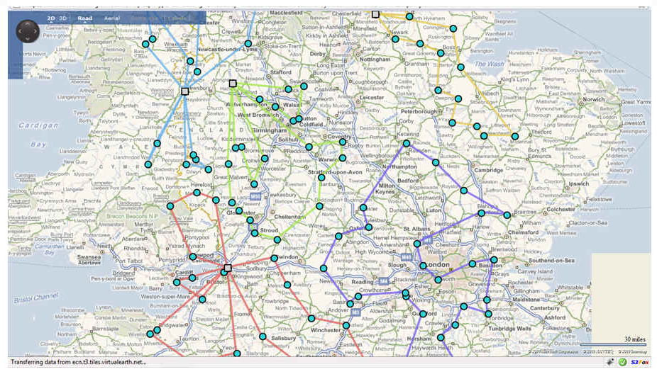

Slide 9
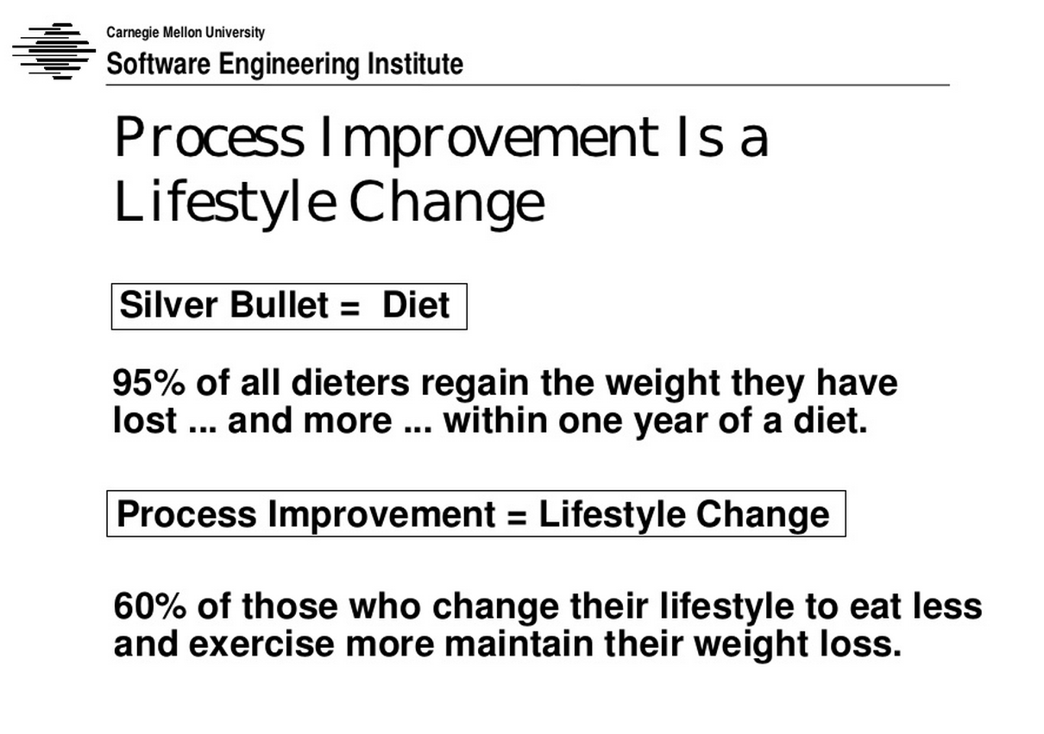

Slide 10
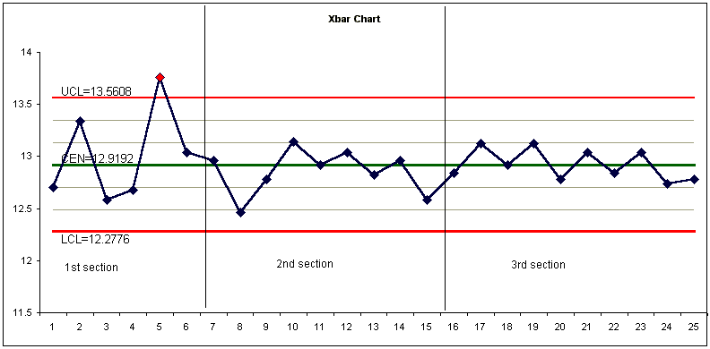
Process stability = nutrient stability

Slide 11
Start of 5 year plan
to improve nutrition
Jolyon Nicks

Slide 12
What did I do?

Slide 13

What did I do?
Goal
Stabilise nutrient intake (in progress)
Start now – hope to achieve between 3 and 12 months

Slide 15

What did I do?
Goal
Establish accurate monitoring
kCals, Protein, Carbs, Fat, Veg portions
Nutrients (possible in future)
Establish accurate costing
Review Results

Slide 16
How did I do it?

Slide 17
How did I do it?
Select meal plan (approach)

Slide 18


Slide 19
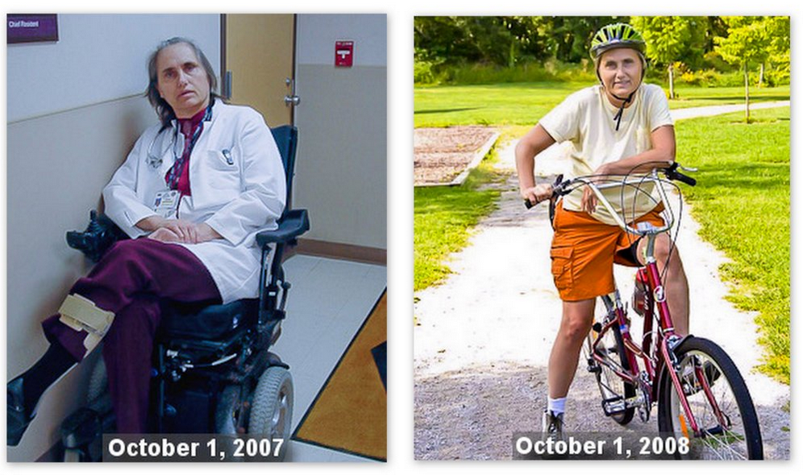



Principles
9 – 10 portions veg
160g protein

Slide 20
How did I do it?
Select Apps – “pilot”

Slide 21
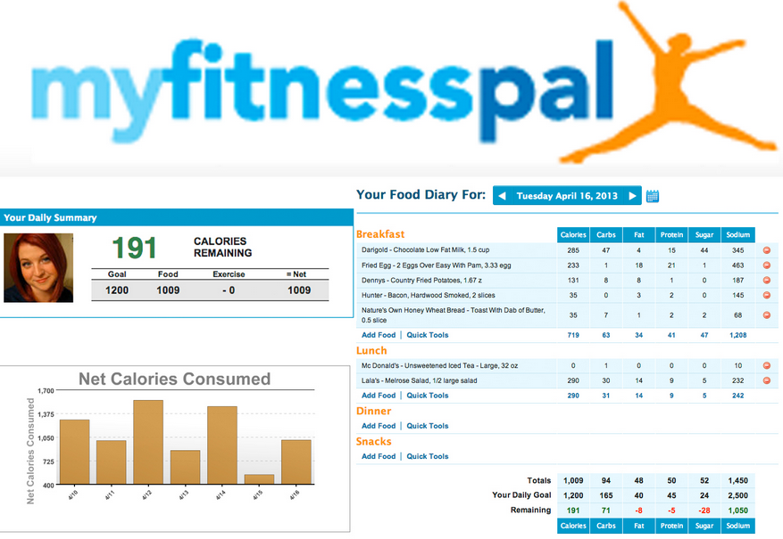



Slide 22


Slide 23
How did I do it?
Make it doable – high admin cost
Simplified meal plan
Simplified routine – prepare all in one session
Avoid other options (but make sure it is not restrictive)
Review results
Compliance (easy)
Stability (baseline)

Slide 24
What did I learn?

Slide 25
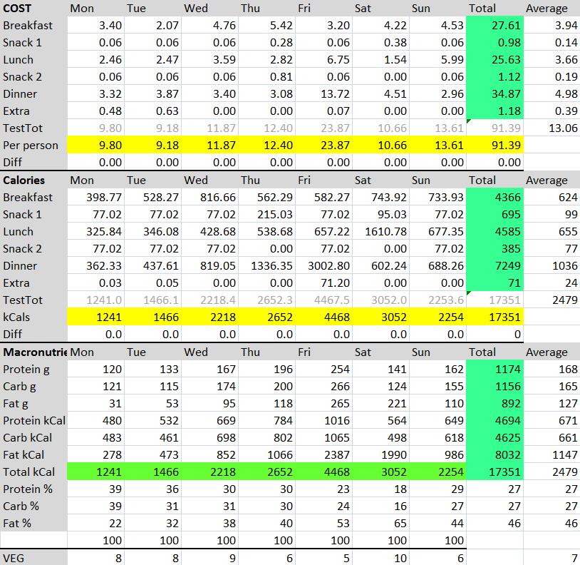
What did I learn?

Slide 26
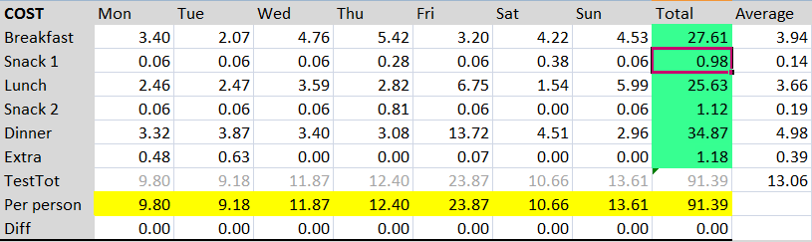
What did I learn?

Slide 27
What did I learn?
This was first stab with specific increases in vegetables, fruit and meat – so over time will investigate why it is so high
Total cost high
£91.39
Only supermarket bought food and simple ingredients (not processed)
No takeaway
£20 to £50 per person per week https://www.avforums.com/threads/how-much-do-you-spend-on-food-and-household-goods-per-week-per-person.1793660/

Slide 28
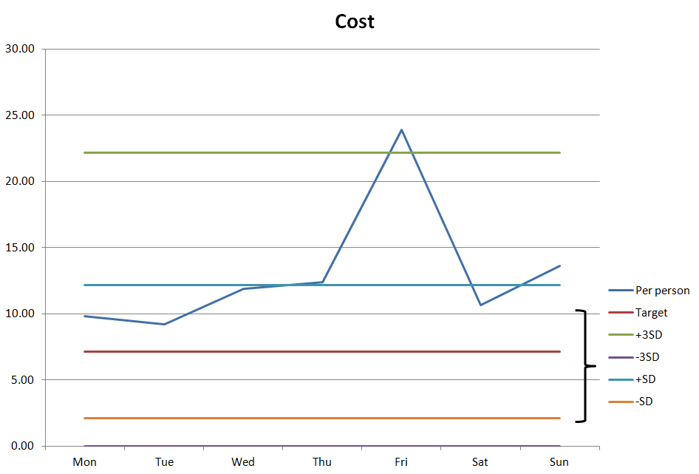
Target = £50 per week per person which is still high

Slide 29
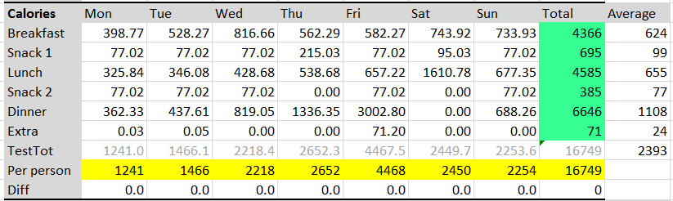
What did I learn?

Slide 30
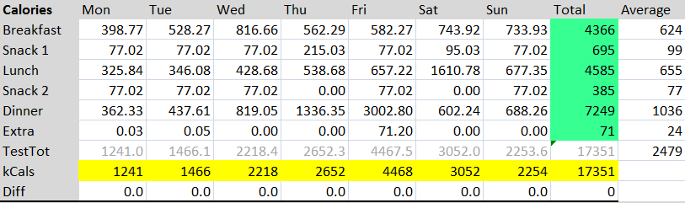
What did I learn?
Average is OK
kCal variation too high

Slide 31
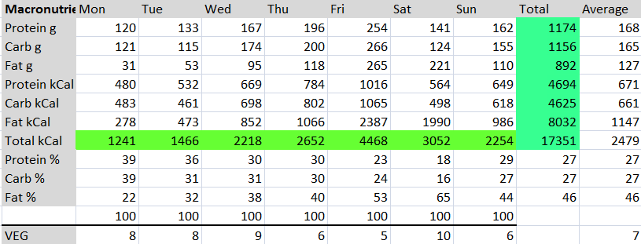
What did I learn?

Slide 32
What did I learn?
Look at protein

Slide 33
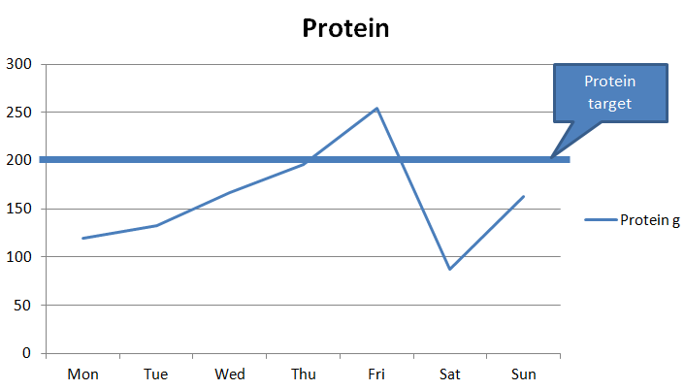

Slide 34
What did I learn?
Prep time required is almost half previous level
Eliminate poor quality (processed meals)
Time dropped compared to preparing each meal
Quality improved – much more satisfying and appealing meals
Meal plan selected >>> needs attention
kCals approx 1500kCal which is far too low
Need expert to plan meals properly

Slide 35
What did I learn?
Next – keep going
On the right track >>> stabilise intake
Measure output – exercise and activity for total energy balance
Find best app – quite like mywellness from Technogym which integrates lots of apps
Once nutrition is stable watch health factors for stability
Once stable correlate with changing energy demand (eg endurance activity)

Slide 36
Next time - Exercise

Slide 37
That’s all folks
Jolyon Nicks

Slide 38
Reference
Bill Phillips – Body for Life
Carl Honore - Slow
Dean Ornish – low fat
Robert Atkins – low carb
Helen Maynier – Naturopath
James Duigan – Bodyism
Jason Vale – juice king
Kristin Shaffer - Preparing Meals for the week in under 2 hours
Marilyn and Harvey Diamond - Fit for Life
Nick Hall – Online meal plan
Nick Mitchell – Ultimate Performance
Tim Ferris – 4 hour body
Patrick Holford - Holford Diet
Pax Beale - Body for the Ages
pH Miracle – Robert O Young
Robert Atkins – low carb
Sarah Dodd – Nutritionist
Sue Davis – Personal Trainer
Terry Wahls – Mitochondria
The Medicinal Chef – Dave Pinnock
Tim Noakes - Lore of Running
Richard Phillipps – Embody
DaxFit – Dax Moy
Sharpbodies – Tim Sharp
Body Synergy – Lee Wiliams

Slide 39
Other metrics
Health
20 indicators
Exercise
60 mins 120 bpm output
Morning HR
10km time trial
Strength
Flexibility

